Slide 1
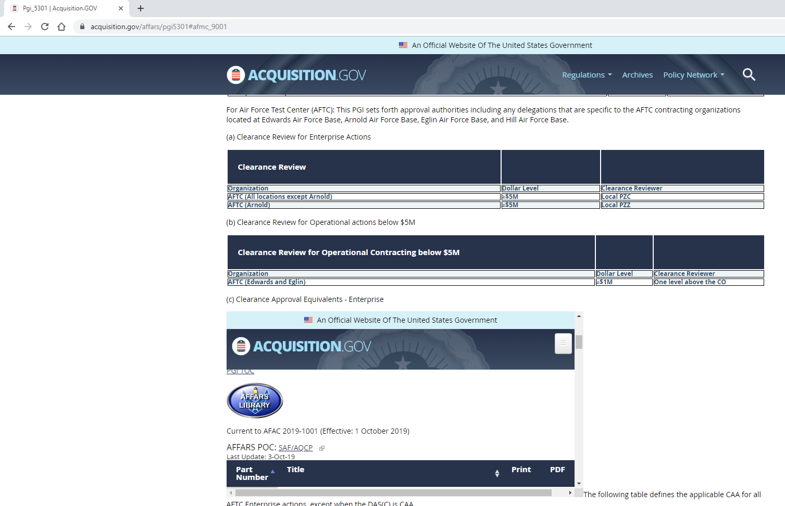
PGI number & paragraph (pgi5301#afmc_9001)
This cell should read:
≥$1M < $5M
This window does not belong here. I believe a program glitch is making them appears here.
There is also another one below it on the webpage.

Slide 2
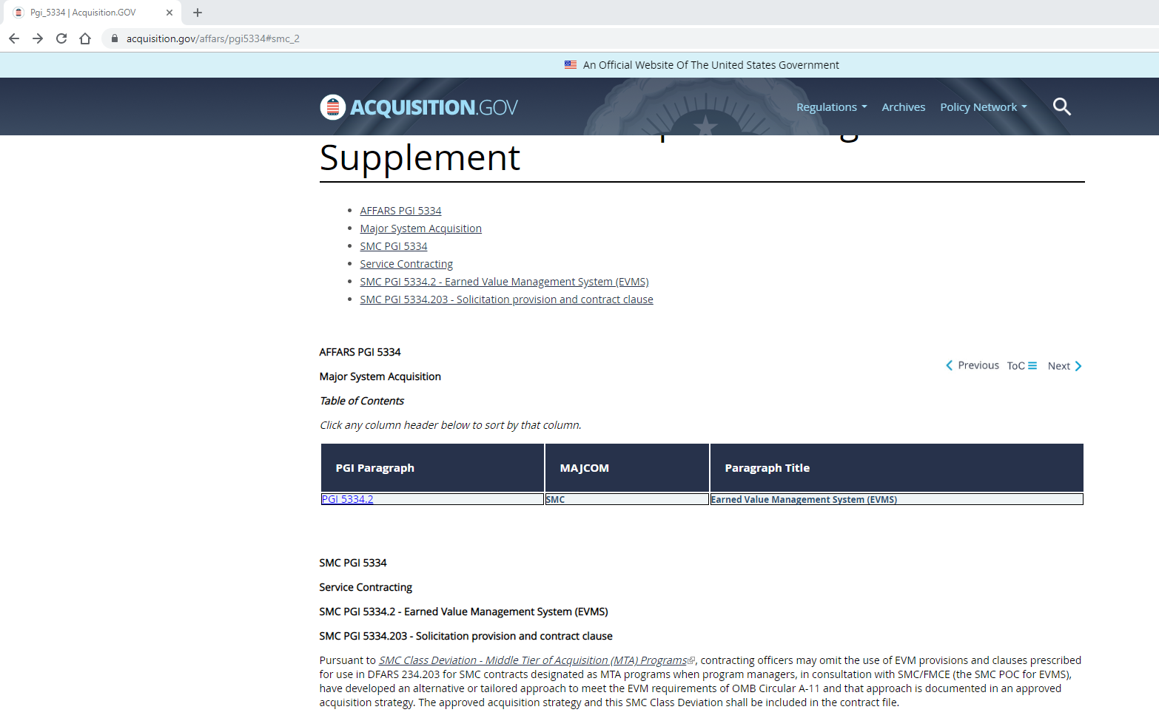
PGI number & paragraph (pgi5334#smc_2)
Please delete “Service Contracting”. It is not part of 5334 and was not included in the Word file that was provided.

Slide 3
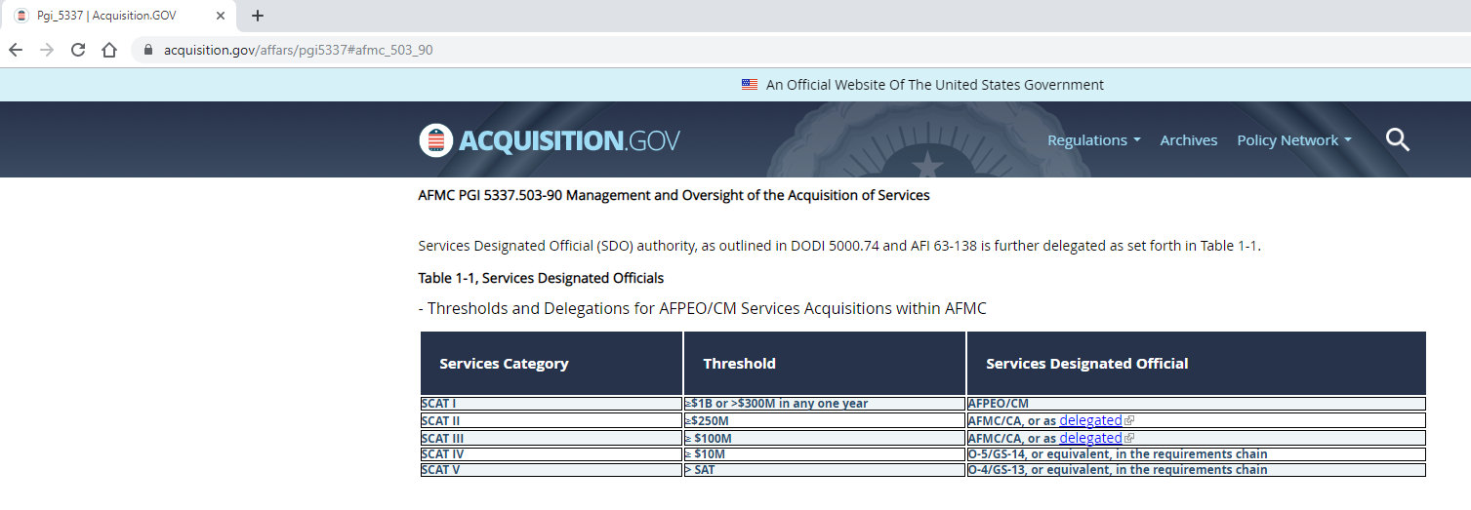
PGI number & paragraph (pgi5337#afmc_503_90)
These cells are missing some content.
This is what the content should be.
Threshold
≥$1B or >$300M in any one year
≥$250M <$1B
≥ $100M < $250M
≥ $10M < $100M
> SAT < $10M

